Slide 1
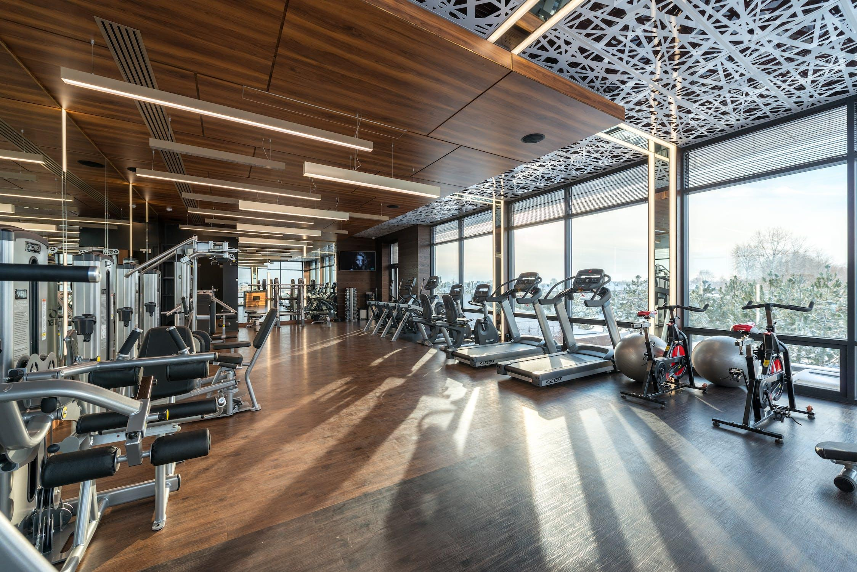
FlipFit Application Gym Management System
Group-D

Slide 2
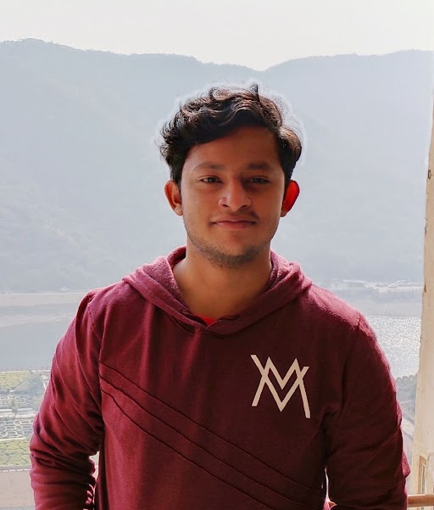
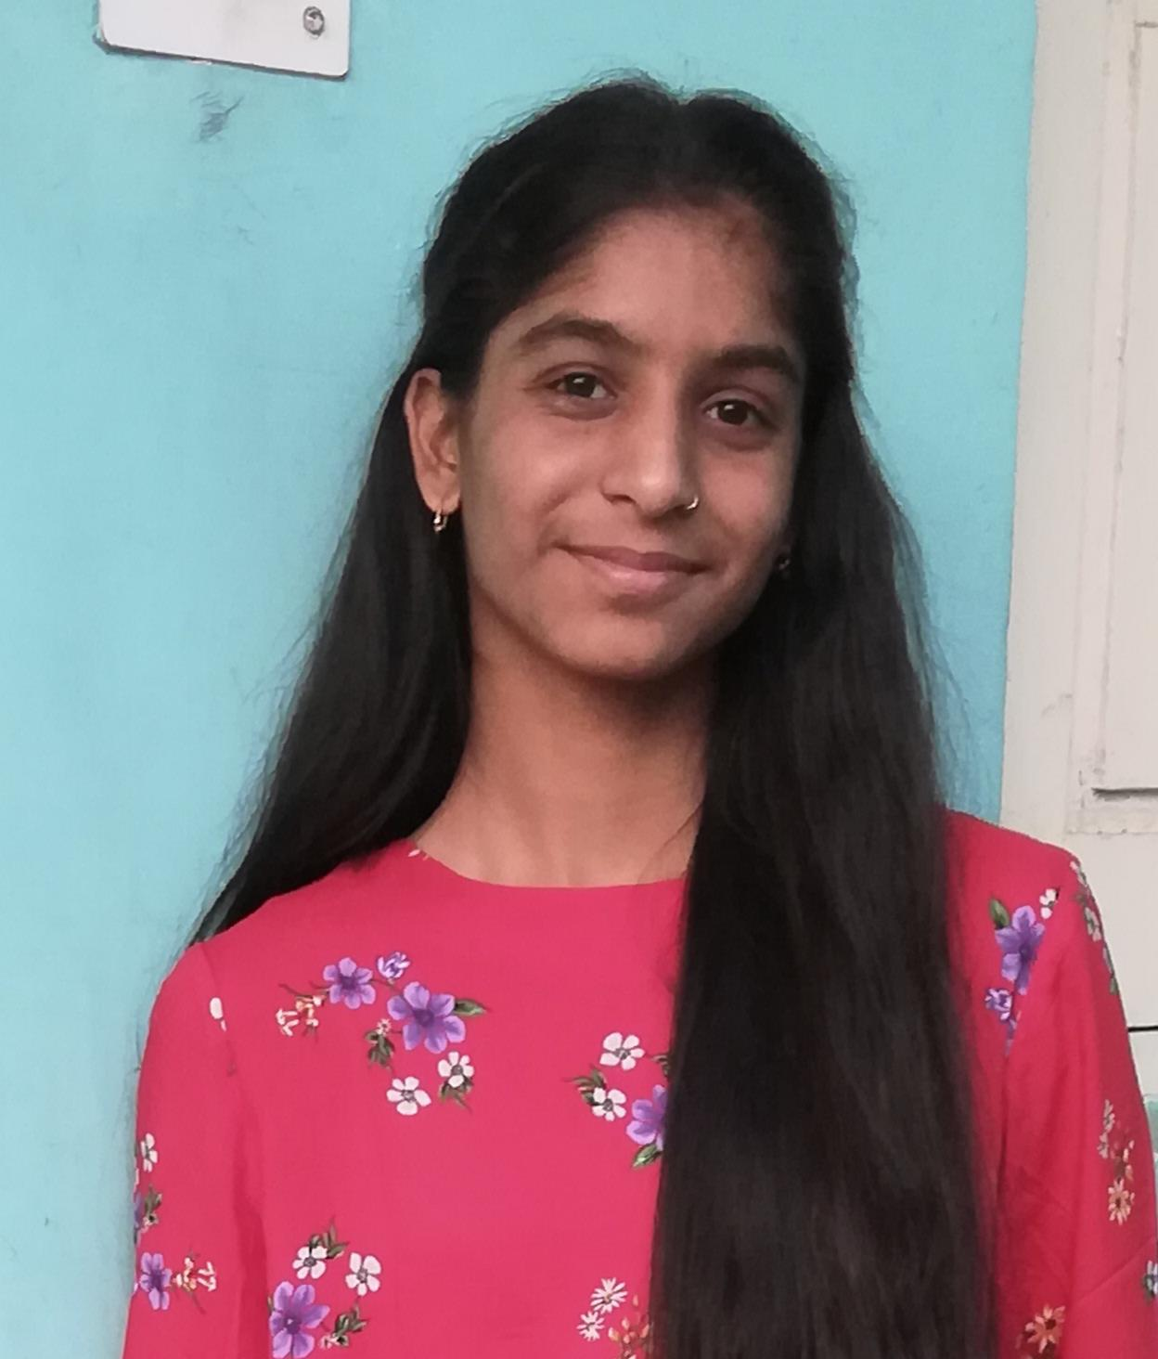
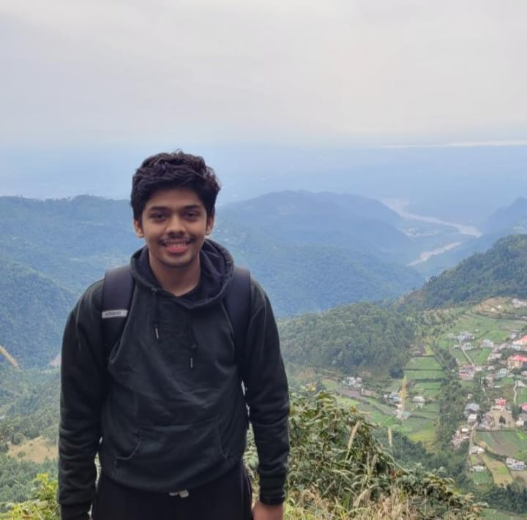

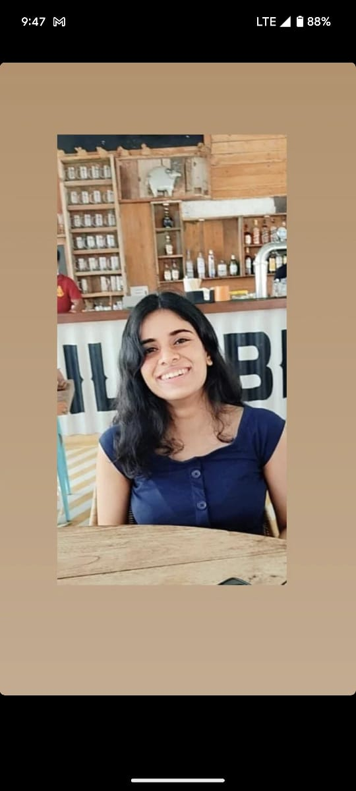
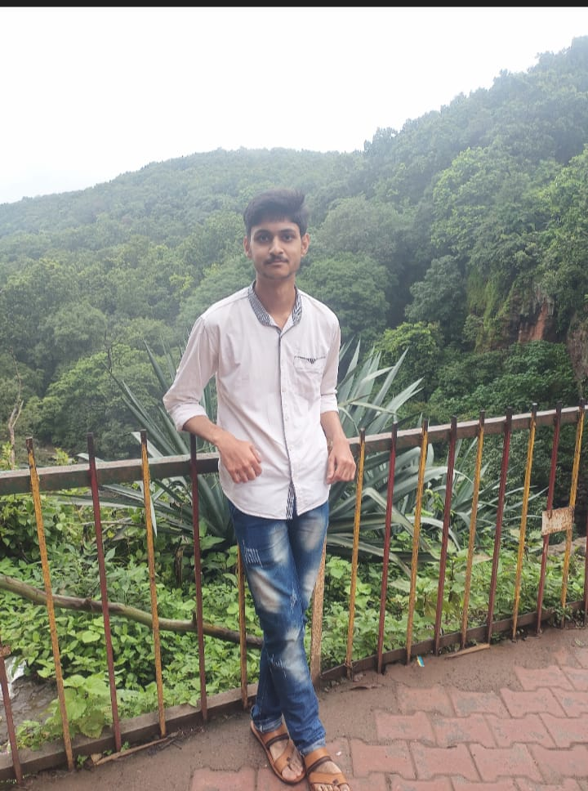
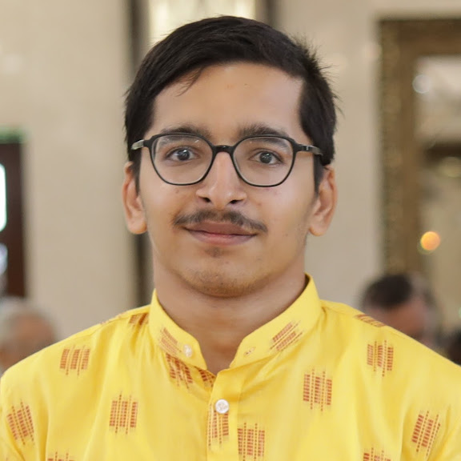


MEET OUR TEAM
Arjun
Janhavi
Anish
Simran
Koyna
Phalashi
Aashay
Rahul
Shivam

Slide 3
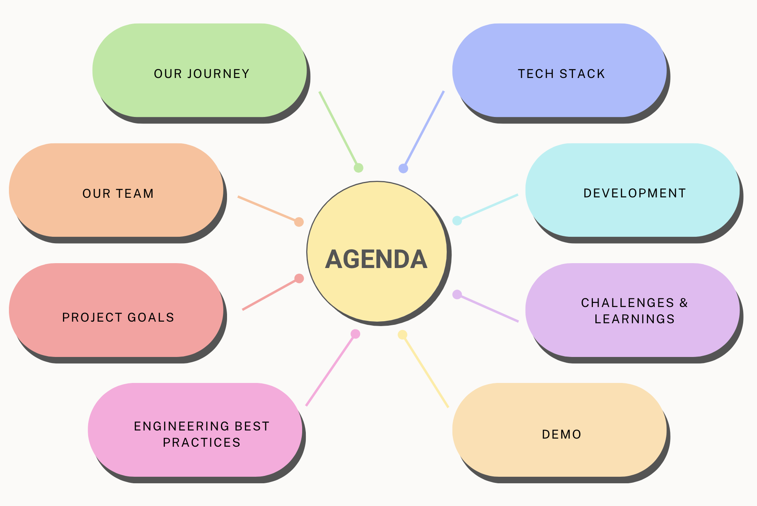

Slide 4
Framework for 7 days
Daily Discussions: Engage in daily discussions covering diverse topics and technologies.
Interactive Brainstorming: Take regular sessions with SME for collaborative problem solving.
Project Planning: Ensure alignment with project goals and milestones.
Hands-on Application: Encourage practical exercises for skill development.
Progress Assessments: Regularly assess and Adapt the plan based on feedback and challenges.

Slide 5
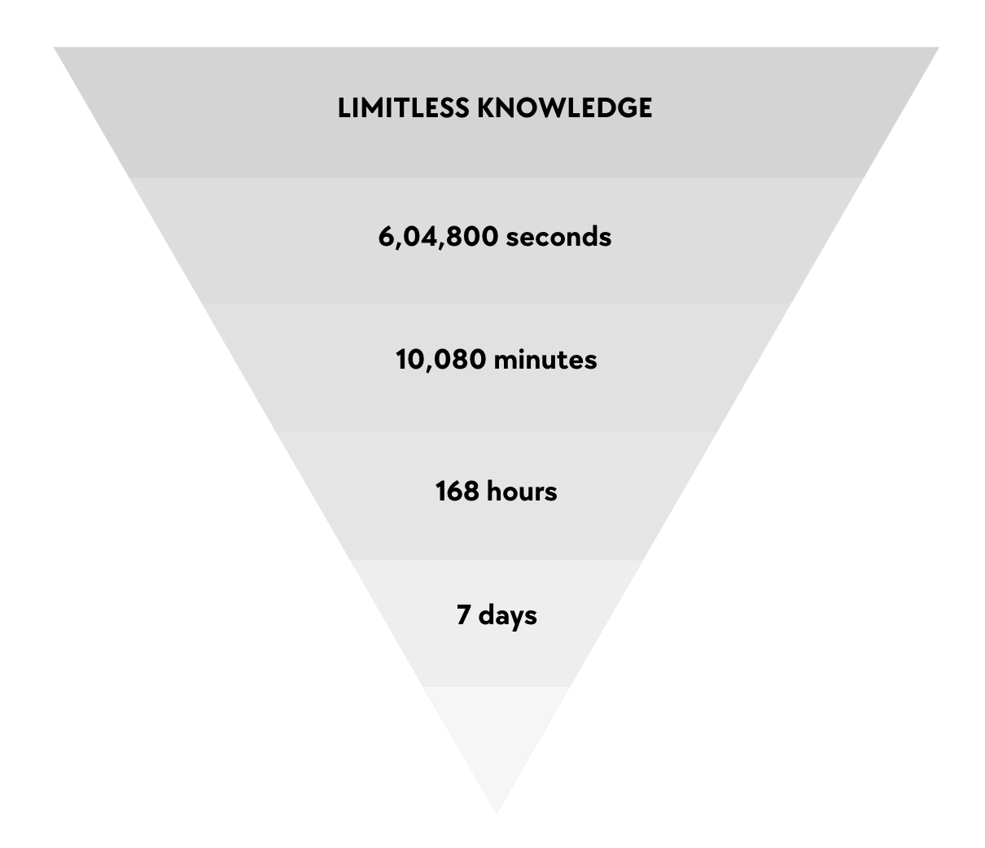
7 Days of Training

Slide 6
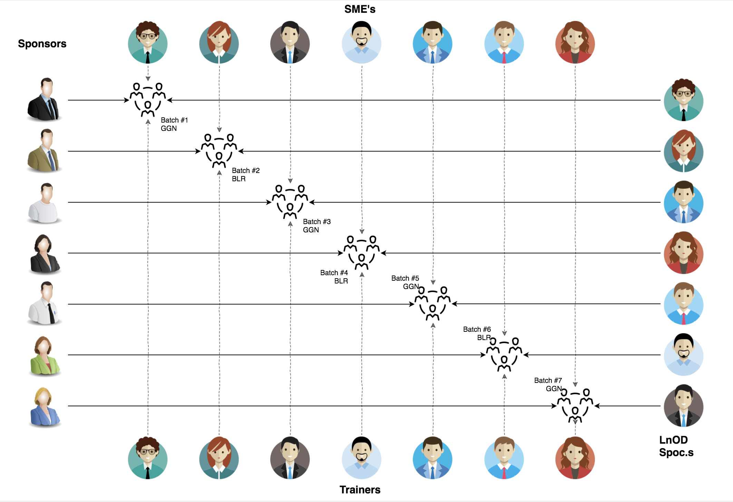
Stakeholders
Sponsors
Flipkart
SME’s
Amit Balyan
Trainers
Sharath Ramesha
‹#›

Slide 7
OUR VISION
Our vision is to design and implement FlipFit Application, a Gym Management System that seamlessly connects fitness enthusiasts, gym owners, and administrators.
It allows individuals to easily discover nearby gym centers, explore available slots, and efficiently book or cancel sessions.
For gym owners, a comprehensive dashboard is provided, enabling them to register their facilities, manage slots, and gain valuable insights into their business, including viewing bookings.
Administrators play a crucial role in allowing efficient approval of gym owner registrations, validation of gym registrations, and overall governance of the FlipFit ecosystem.

Slide 8
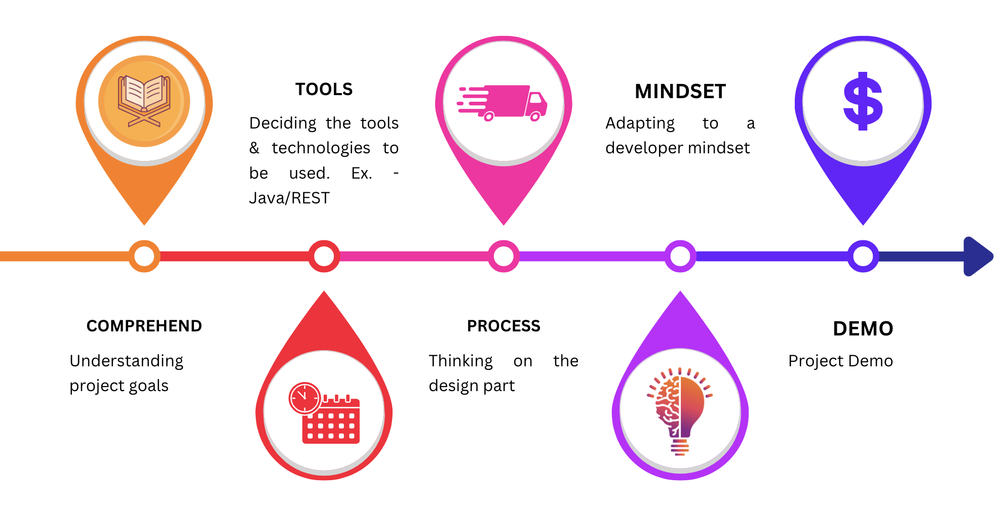
OUR JOURNEY

Slide 9
Engineering Practices
Code Refactoring
We have regularly reviewed and refactored code to improve its structure, readability, and maintainability.
Modularity and Interfaces
The codebase is designed with modularity in mind, facilitating easy maintenance, updates, and additions. Well-defined interfaces between components ensure clear communication and collaboration among different parts of the system.
05
01
04
Documentation Practices
Comprehensive documentation, architecture diagrams and code comments are done to ensures that knowledge is shared effectively.
Database Management
We employ robust database management practices, utilizing relational databases for structured data about centers and bookings. This ensures data integrity, consistency, and reliability.
02
03
Version Control and Git Workflow
We followed git for branches, pull requests, and code reviews. This ensured collaboration, traceability, and a systematic approach to development.

Slide 10









TECH STACK
Backend
Database
Tools
Documentation
UML Diagrams
Dropwizard

Slide 11
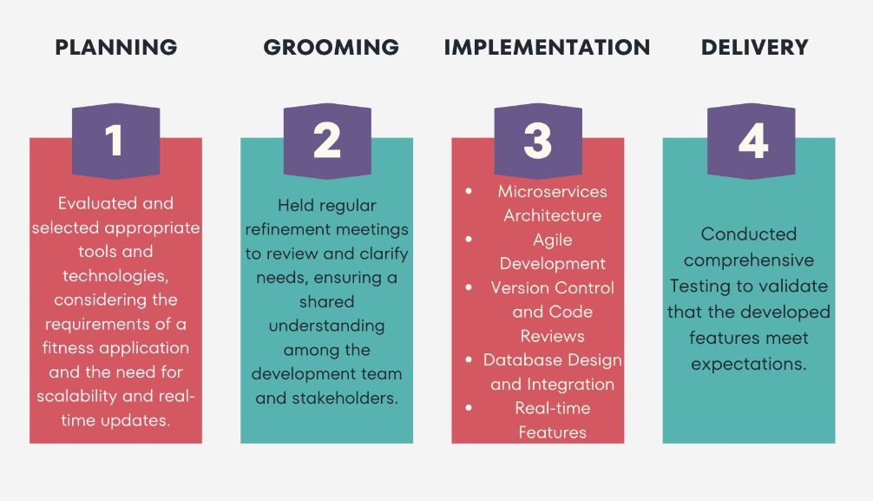
DEVELOPMENT PROCESS

Slide 12
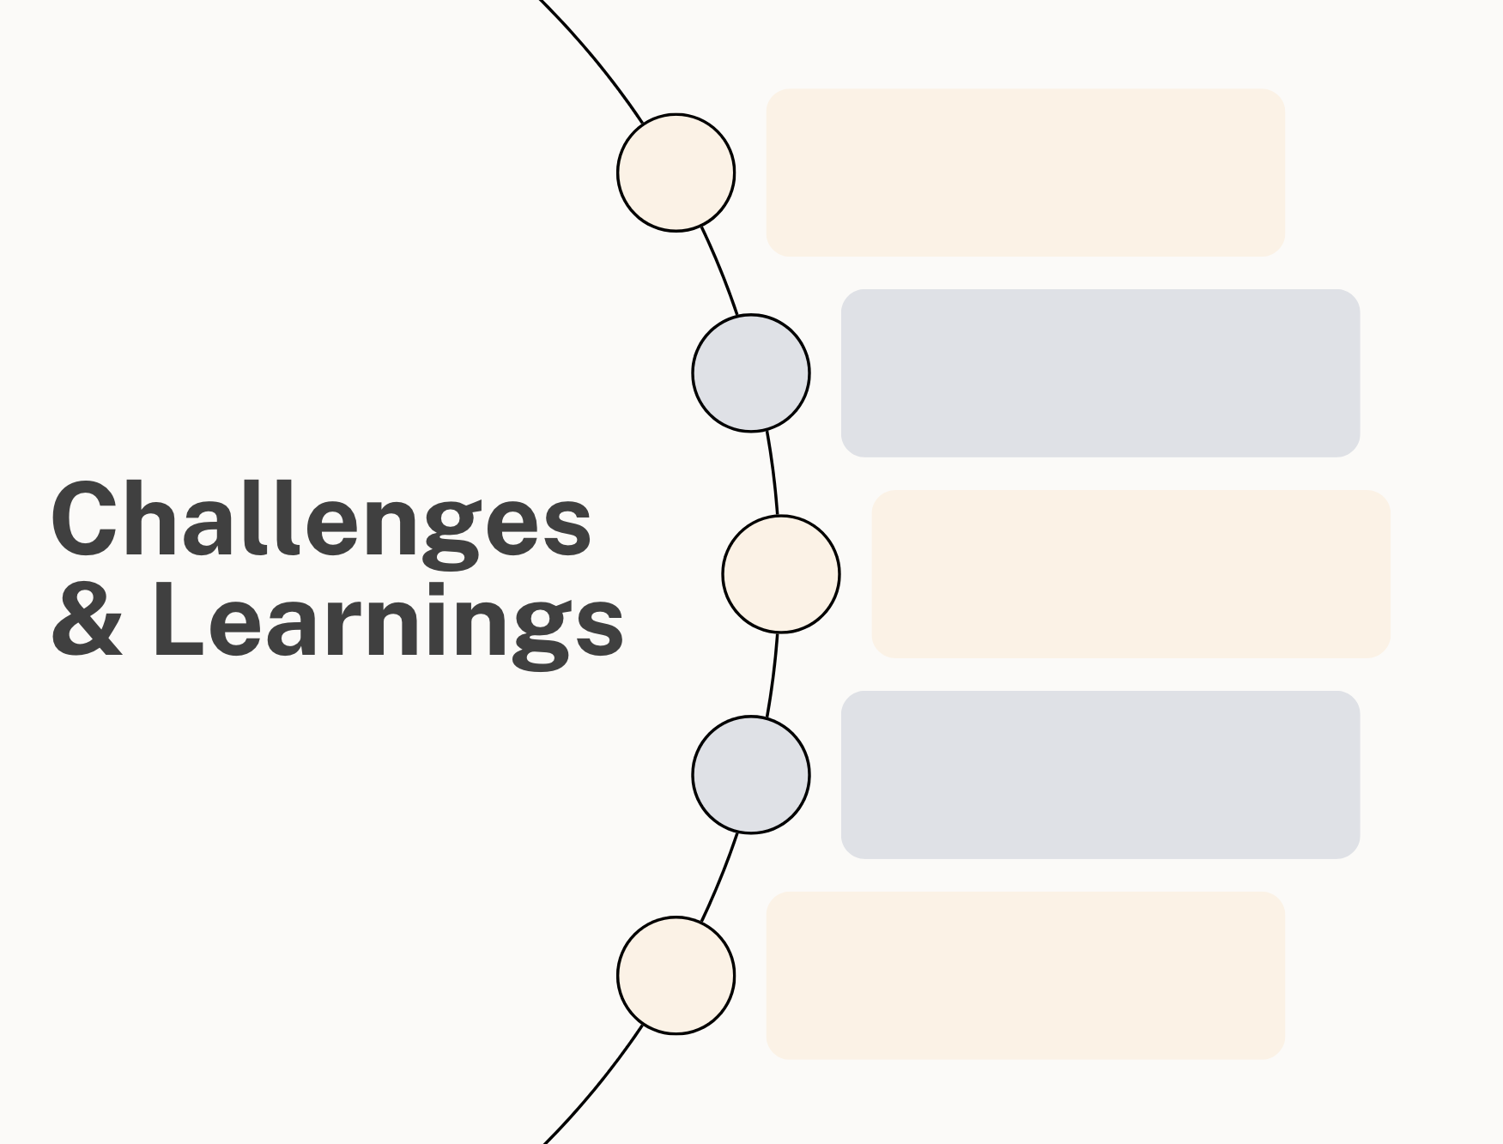
Code Consistency
Version Control
Scope & Strategize
Integration Testing
Tight Schedule

Slide 13
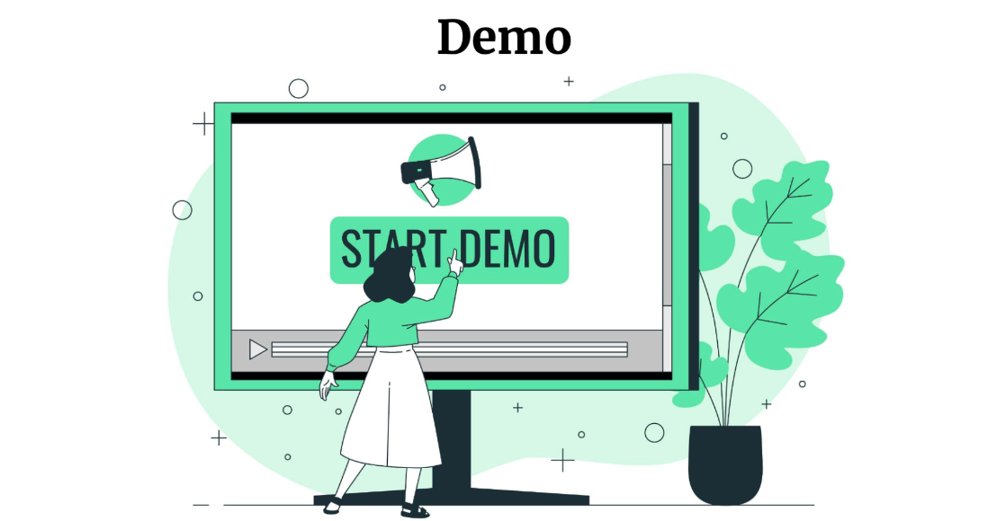

Slide 14
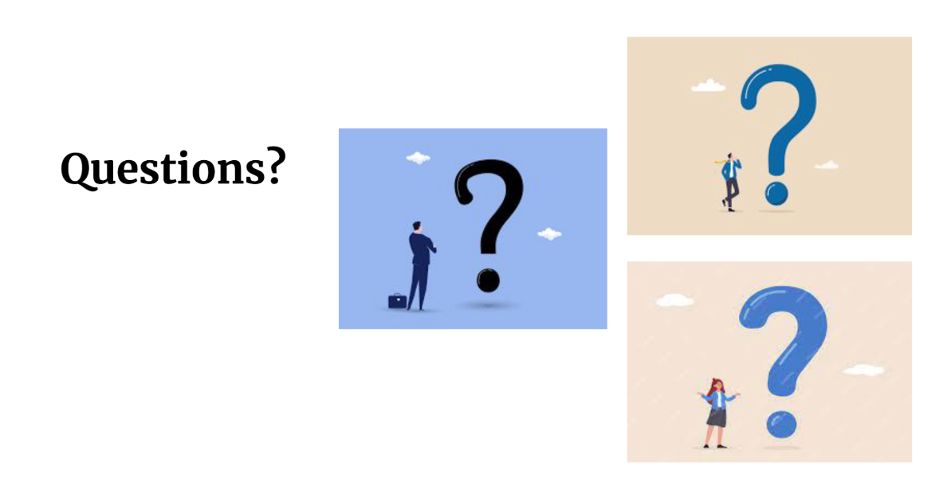

Slide 15
